Slide 1
Scaling DevOps
Owen Gardner
October 2014

Slide 2
Content
The Background
The Challenge
The Initiative
The Outcome

Slide 3


The Background
1690
Year Founded
144,000
Total staff Globally
22,000
Technical staff
13,000
Tools/
versions
6,000
teams/ platforms

Slide 4

The Challenge
At the team layer…
Focus on next delivery
Unique challenges
Where to start?
At the management layer…
Where are the problems?
Where to start?
What progress?

Slide 5
The Initiative
Development
“Delivering better quality software to the production environment quicker”
App
Support
QA
Dev
Ops
Three parallel streams:
Technical & Process debt
Measuring against “Good”
Supporting teams:
Reducing debt & risk
Moving toward “good”
Providing transparency

Slide 6
Engagement with Teams
X
Centralised Team
Iterates through each team
Non-scalable, team 5999 has a long wait.
Overall metrics are unavailable
Debt grows
Team 5
DevOps CoE
Team 6
Team 7
Team 5999
Team 4
Team 2
Team 1
Team 3
DevOps CoE
Cluster DevOps
CDR DevOps
Dev Manager DevOps
Set Process
Generate metrics
Support “Big Rocks”
Engage with teams
Report progress
Define “Big Rocks”
Federated Team
Metrics available quicker
All teams engaged quickly
Highly scalable
Debt is more rapidly controlled
✓
Team 1
Team 2
Team 3
…
Team 5998
Team 5999

Slide 7
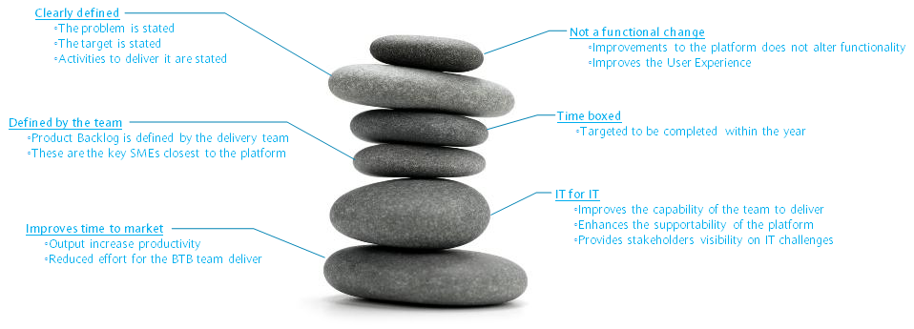
Stream 1 – Technical Quality & Debt
“If you can’t measure, you can’t improve.”
What
Determine quality and debt across the organisation
Including team specific remediation plans for highest priority items
How
Input
Iteratively apply tooling at an enterprise level.
Includes code, test, change, requirement, maturity, etc.
Output
Information presented to different levels of the organisation - Dashboard
Remediation established at delivery team level - Big Rocks

Slide 8
Stream 2 – Defining “Good”
“If you don’t know where you are going, you’ll end up someplace else.”
What
Establish best practices and processes for teams to deliver software
Measure the maturity of delivery across the group and report status
How
Input
Create “Barclays DevOps Guidelines”
Produce this data in a digestible format, with maturity levels
Output
Regular report on gap analysis between current and “Good”
Determine steps to close the gaps - Big Rocks

Slide 9
Stream 3 – Supporting teams
“Improving daily work is even more important than doing daily work”
What
Support teams in defining and resolving their Big Rocks
Provide transparency on the non-functional work done
How
Input
Establishes the biggest challenges faced by the delivery teams.
Prioritise those challenges with the team, set resolutions and milestones
Output
Identify macro scale Big Rocks and coordinate enterprise solutions
Leverage peer team knowledge
Regularly report status for Big Rocks

Slide 10
Progress
2012 – white paper written
2013 - Initially rolled out across team of 160
2014 Q1 – Extended to 1,500 organisation
2014 Q4 – Undertaking to extend across group
22,000 technical staff distributed globally
Programme Manager
Dev Ops
...
DevOps
Team 1
…
Team n
Team 1
…
Team n
Team 1
…
Team n
DevOps
Programme Manager
Programme Manager
Programme Manager
Team 1
…
Team 18
DevOps
DevOps CoE
Programme Manager
Dev Ops
...
DevOps
Team 1
…
Team n
Team 1
…
Team n
Team 1
…
Team n
DevOps
Programme Manager
Programme Manager
Programme Manager
Dev Ops
...
DevOps
Team 1
…
Team n
Team 1
…
Team n
Team 1
…
Team n
DevOps
Programme Manager
Programme Manager
Programme Manager
Dev Ops
...
DevOps
Team 1
…
Team n
Team 1
…
Team n
Team 1
…
Team n
DevOps
Programme Manager
Programme Manager
Programme Manager
Dev Ops
...
DevOps
Team 1
…
Team n
Team 1
…
Team n
Team 1
…
Team n
DevOps
Programme Manager
Programme Manager
Programme Manager
Dev Ops
...
DevOps
Team 1
…
Team n
Team 1
…
Team n
Team 1
…
Team n
DevOps
Programme Manager
Programme Manager

Slide 11
Key Points
Those doing the work know the problems…
…but they may not know it!
Getting visibility on technical and process debt is critical
Hold people accountable – from Developer to CIO
Make this a good experience
Support with empathy and understanding
Give credit easily
All teams have unique challenges ← Embrace this truth

